Slide 1


SUPRIYA.A
IIIrd year BE-CSE
211521104163

Slide 2


PROJECT TITLE:
Neural-Network-based-Image-Stylization

Slide 3



AGENDA
In this project, you'll be exploring the exciting world of neural style transfer, where you'll harness the power of Convolutional Neural Networks (CNNs) to transform images into works of art! You'll build a system that can take a regular photo and apply the artistic style of another image, like a famous painting. We'll delve into the architecture of the CNN, specifically an encoder-decoder structure, to understand how it separates the content (what's in the image) from the style (how it looks). By training the network with clever loss functions, you'll teach it to preserve the content of your photo while infusing it with the artistic flair of your chosen style image. Get ready to see your project generate stunning, artistic images!

Slide 4

Develop a deep learning system using Convolutional Neural Networks (CNNs) to achieve Neural Style Transfer. This system should be able to:
Separate content and style: Given two images, a content image and a style image, the system needs to learn to differentiate between the semantic content (objects, shapes) in the content image and the artistic style (brushstrokes, color palettes) in the style image.
Generate stylized images: The system should create a new image (generated image) that preserves the content of the content image while adopting the artistic style of the style image.

Slide 5
Neural Style Transfer with Convolutional Neural Networks
This project delves into the fascinating realm of Neural Style Transfer, where we leverage the power of Convolutional Neural Networks (CNNs) to transform everyday images into artistic masterpieces.
Our goal is to build a system that seamlessly blends the content of one image (e.g., a portrait) with the artistic style of another image (e.g., a Van Gogh painting). This involves training a CNN to understand the distinct characteristics of content and style in images.

Slide 6
Developers and Researchers:
This group includes individuals interested in the technical aspects of Neural Style Transfer. They might be:
Machine learning engineers:
They would be interested in using and potentially improving the CNN model you build.
Computer vision researchers:
They would be interested in the approach you take to separate content and style information in images and potentially use your project as a foundation for further research.
2. Artists and Creatives: This group would be interested in using your project as a creative tool
Digital artists:
They could leverage your system to create unique artworks by applying various artistic styles to their own images.
Graphic designers: They could explore using the tool to generate stylized visuals for marketing materials, presentations, or other design projects.
Photography enthusiasts: They could use your system to add a creative twist to their photographs by infusing them with different artistic styles.

Slide 7

YOUR SOLUTION AND ITS VALUE
Solution and Value Proposition: Unleashing Artistic Potential with Neural Style Transfer
Solution:
Automated Style Transfer
Content-Style Control
Flexibility
Value Proposition
Enhanced Creativity
Accessibility of Artistic Styles
Efficiency and Time-Saving
PROPOSITION

Slide 8

THE WOW IN YOUR SOLUTION
Transform the Ordinary:
Take any everyday photo – a selfie, a landscape shot, even your pet – and instantly infuse it with the artistic spirit of a renowned artist like Van Gogh, Monet, or Picasso. Imagine your vacation photos reimagined in the style of a classic Renaissance painting!
Instant Artistic Expertise:
No artistic training required! This project empowers anyone to become a virtual artist. Experiment with different styles, discover hidden artistic potential within your photos, and create visually stunning pieces that will leave viewers awestruck.
Democratization of Art:
This technology has the potential to bridge the gap between the art world and the public. Anyone can create art that looks like it came straight out of a museum, fostering a deeper appreciation for artistic styles and movements.

Slide 9
Split image showcasing a transformation:
On the left, a regular photo (e.g., portrait, landscape).
On the right, the same photo transformed with an artistic style (e.g., Van Gogh swirls, Picasso cubism).
Unlock the Artistic Potential of Your Photos (or similar)
Bullet Points:
Transform everyday images with artistic styles.
Explore the works of famous artists.
Create unique and visually striking artwork.
[For Developers] Leverage the power of CNNs for creative exploration (if targeting developers).

Slide 10
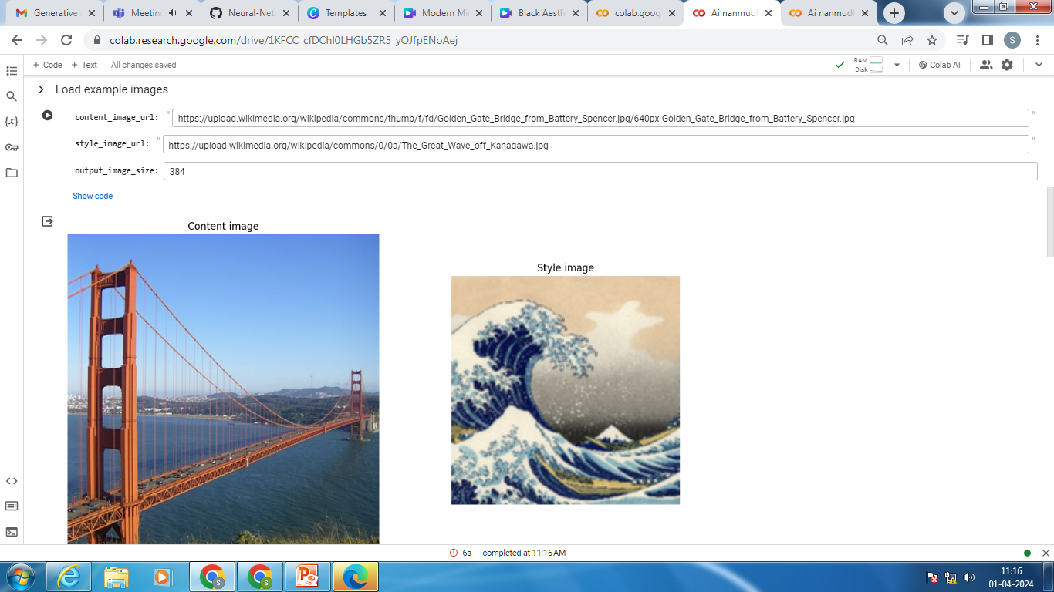

Slide 11
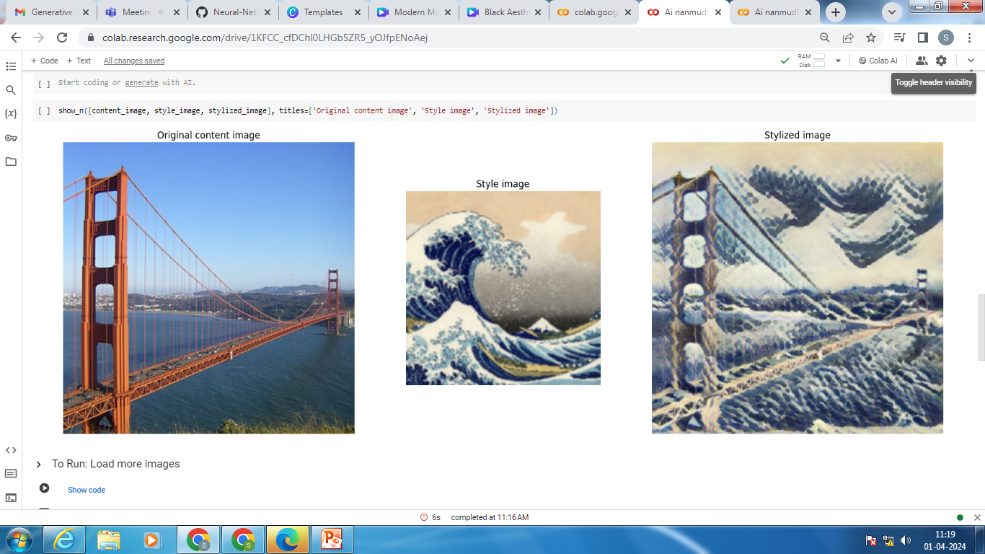

Slide 12
THANK YOU

